Slide 1

Overview
RAVEN workshop
C. Rabiti, A. Alfonsi, S. Sen, D. Maljovec, P. Talbot, R. Kinoshita, D. Mandelli, J. Cogliati
PSA 2015 - April 26th 2015, Sun Valley (ID)

Slide 2
RAVEN
Risk Analysis Virtual ENvironment

Slide 3
Project Background
RAVEN was started in early 2012
Supported by the Nuclear Energy Advanced Simulation (NEAMS) program
The Light Water Reactor Sustainability (LWRS) program is the major customer and supporter
The overall goal was to have a tool to enable Risk Informed Safety Margin Characterization (RISMC)
Evaluating risk (uncertainty propagation)
Understanding risk (limit surface, ranking, sensitivity, data mining)
Mitigating risk (optimization)

Slide 4
For Which Type of Systems
Uncertainty in system response
Uncertainty in initial and boundary condition
Uncertainty in model parameters
Stochastic events
Possibly dealing with discrete variable
Highly non linear systems
Probability distribution of the final status
Uncertainty in initial condition

Slide 5
Which Tools
Risk Management
Risk Evaluation
Risk Analysis
Risk Mitigation
Probability
Consequence
Ranking
Optimization
Probability functions
Sensitivity
Limit Surface
Sampling
Surrogate Models
Dynamic Event Trees
Adaptive Dynamic Event Trees
Data Mining

Slide 6
How
RAVEN could interact with a physical model by:
Wrapping the code simulating the physical moment
Exchanging information at each time step (only for RELAP-7 and MOOSE based application soon)
Leveraging already existing control logic structure in the code (e.g. RELAP5-3D for Dynamic Event Trees)
RAVEN Input File
RAVEN
Distribution
Variable ID
Code Input
Sampling
Input syntax
User Built Interface
Run manager
Output Reader
Storage
Values
New
Input
New
Output
Data

Slide 7
Parallel Environment
Sampling is a very expensive computational operation
Modern codes are already parallel using MPI and multithreading
RAVEN manages concurrent runs of already parallel codes
Job 1
Thread 1
MPI 1
Job 2
Thread 2
RAVEN
JobHandler
MPI 2
Job ...
Thread ..
MPI ..
Thread J
Job N
Batch Size
MPI M

Slide 8
The Building Blocks
RAVEN is organized in a modular fashion where “entities” can be used to construct the sought workflow
The building blocks are:
Distributions: describe the probabilistic behavior of variables
Samplers: associate the distribution with a variable and a sampling strategy
Models: represent the system to be explored or more generally an input output relationship
The actions (Steps):
MultiRun/Run: feeds an input to a model to retrieve an output, if a sampler is present the model is sampled according
Postprocessor: investigate outputs to determine their statistical characterization and relate the output to the input
IO: export import data where the output are stored

Slide 9
Probability Distribution Functions (1D)
Most common used 1D distributions (Boost)

Slide 10
Probability Distribution Functions (ND)
Multivariate distributions appear in many practical problems
They are challenging from two points of view:
Construction and evaluation
Sampling (they are not invertible)
RAVEN manages
Multivariate normal:
Custom, user-provided distributions (supplied as a file of evaluated points)

Slide 11
Samplers (non-Adaptive)
Choose how to sample the input (parametric) space:
Impacts how effectively the input space is explored
Determines the probability associated with each realization of the output
RAVEN supports many non-adaptive samplers
Monte Carlo
Grid
Equal-spaced in probability
Equal-spaced in value
Mixed
Custom
Stratified (LHS type)
Equal-spaced in probability
Equal-spaced in value
Mixed
Custom

Slide 12
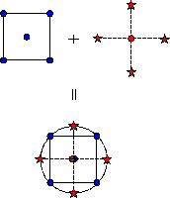
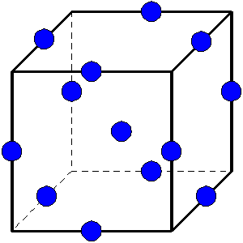
Samplers (non-Adaptive) Cont.
Factorial Designs:
General Full Factorial (grid)
2-Level Fractional-Factorial
Plackett-Burman
Response Surface Designs:
Box-Behnken
Central Composite
Central Composite
High density sampler focused on full coverage of the input space (highly discontinuous and nonlinear response, low dimensionality)
Box-Behnken

Slide 13
Spatial Distribution Examples
Latin Hypercube (100 points)
Grid (1764 points)
Monte Carlo (300 points)

Slide 14
Dynamic Event Tree
Probability
Intrinsically-stochastic systems cannot be controlled by the initial condition
Pressure
Time
Pipe failure pressure
Failure @66% CDF
Cumulative Distribution Function (CDF)
Failure @33% CDF
Pressure
Pressure
Time
Pipe failure pressure
Time

Slide 15
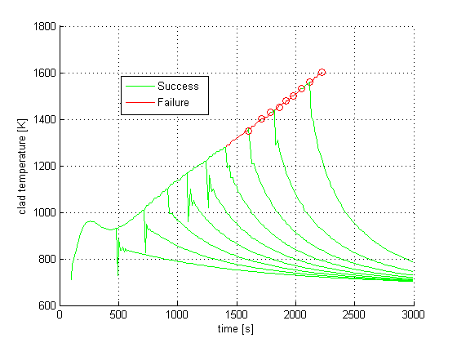
Dynamic Event Tree (DET) Example
Clad Temperature [K]
* = system success
* = system failure
All the tree branches are assembled to reproduce the full evolution
Time [s]

Slide 16
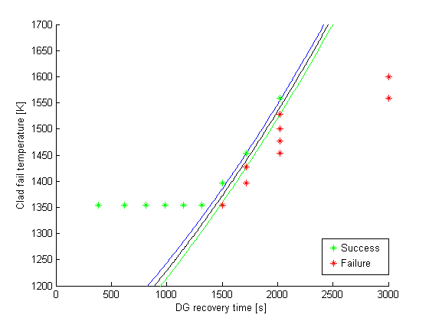
DET Follows Failure Patterns
* = system success
* = system failure
Clad branching:
DG branching:
Clad Failure Temperature [K]
The consideration of uncertainty on clad failure temperature leads to a natural refinement of the analysis around the failure prone input space
Increase the delay in the recovery of the DG until…
The first clad failure threshold is reached
DG Recovery Time [s]

Slide 17
Models
At the software level, models relate input to output
It might be more convenient to think about a model as software simulating a physical system
Within this context the following models are available:
Code: an external code that RAVEN can inquire via properly-built interfaces to manage input and output
External model: a numerical implementation of a physical model that is interfaced to RAVEN directly (no file exchange) using RAVEN’s API
An internally generated surrogate models (ROM)

Slide 18
Data
RAVEN posses four main data type
Time Point Set
Time Point
Input Set
Output Set
Histories
History
Input Set
Time series
Many
Many
For a set of the input parameters ... the corresponding figures of merit

Slide 19
Statistical Post Processing
Statistical characterization of the output (uncertainty propagation)
Mean
Sigma
Skewness (asymmetry)
Kurtosis (more/less peaked than a standard normal)
Input/output relationship (ranking/sensitivity)
Correlation matrix
Covariance matrix
Sensitivity matrix (multidimensional linear regression)
Normalized sensitivity matrix (% change of the response / % change in the answer)

Slide 20
Input/Output Relationship
Correlation matrix
Covariance matrix
Sensitivity matrix
Normalized sensitivity matrix
 | Input Parameters |  | Output FOM
Input Parameters
Output FOM
Input Correlation
Input to Output Correlation
Output Correlation

Slide 21

Advanced Post Processing
RAVEN gives access to several data mining algorithms for data post-processing via implementation of APIs between RAVEN and Scikit-learn*
Cardinality Reduction algorithms aim to recognize commonalities among the data - Clustering, Gaussian Mixture Models, etc.
Dimensionality Reduction algorithms are used to reduce the number of degrees of freedom in the data under consideration – Manifold Learning, Decomposing Signals in Components, etc.
In principle data mining makes no distinction between input and output
*http://scikit-learn.org

Slide 22
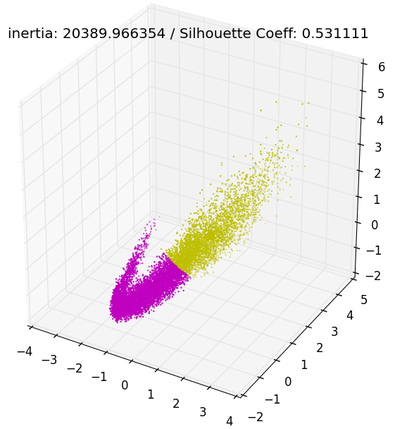
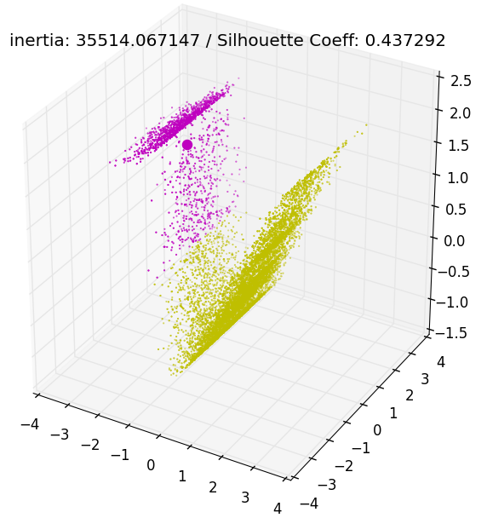
Application to BISON Fuel Analysis
~17,000 simulations, 3 input parameters
power_scalef | Power scaling factor of the core
grainradius_rscalef | Scaling factor of the grain size in the fuel microstructure
thermal_expansion | Thermal expansion coefficient of the fuel
Fission Gas Released
K-Means algorithm (Lloyd’s algorithm)
No. Clusters: 2
Mid-PLane Vonmises Stress
Average Interior Temperature
Grain Radius Scale Factor
Average Clad Temperature
Power Scale Factor
Output Space
Input - Output Space
Notes:
Kmeans Algorithm: clusters data by trying to separate samples in n (number of clusters (given by user)) groups of equal variance, minimizing the criterion known as inertia. It scales well to large number of samples, and has been widely used in different fields.
Inertia: the within-cluster sum of squares criterion, can be recognized as a measure of how internally coherent clusters are.
Silhouette Coefficient: Silhouette refers to a method of interpretation and validation of clusters of data. The technique provides a succinct graphical representation of how well each object lies within its cluster.
The best value is 1 and the worst value is -1. Values near 0 indicate overlapping clusters. Negative values generally indicate that a sample has been assigned to the wrong cluster, as a different cluster is more similar.

Slide 23
Simple Workflow
Definition of the distributions to be used
Definition of the sampler
Association of variable name(s) with distribution(s)
Choice of a sampling strategy
Definition of the data structure(s) for internal storage
Evaluation step
The distributions are sampled according to the sampler
The variables are associated to the values
The model is executed as many times as the sampler requires
The inputs and corresponding outputs are stored in the data structure(s)
Post-processing
The data is analyzed according to requested type of post-processing
I/O
Data is saved for further analysis

Slide 24
Reduced Order Models (ROM)/Surrogate Models
Not for all possible inputs, but for a range of possibilities…
Not for all possible geometries, but for a parametric range…
Not to represent all outputs, but for some of the outputs…
It is possible to:
-Build a set of equations of faster solution with respect to the original set
-Increase the prediction capabilities by further training

Slide 25
Using Surrogate Models
Simulation 1
Simulation 2
ROM Training
Sampler
+
Distributions
Sampler
+
Distributions
Model (Code)
Model
Data Base
Post Processing
Post Processing

Slide 26
Available Surrogate Models
The surrogate models available are:
Supervised algorithms available from scikit-learn
SVMs
Nearest neighbor
Gaussian Process
Etc…
Inverse weight
ND spline (only regular Cartesian grids)
Generalized Polynomial Chaos Expansion
RAVEN has an API to implement your own surrogate model

Slide 27
Reliability Analysis (Limit Surface)
System response depends on many variables but often what matters are a few figures of merit
What is the probability of exceeding the threshold?
Which parameter is the most influential?
Which uncertainties affect my margins the most?
Trying to avoid high temperature regions
High Risk Direction
Excessive Temperature Region
Risk Neutral Direction

Slide 28
The Limit Surface: Simulation Flow
Training on initial small number of sampled points
A fine grid is classified (failure or success) based on a nearest-neighbor algorithm (sampling of the surrogate)
The limit surface is identified by the location of transition between failure/success
The furthest point on the limit surface from any other already tested point is chosen to test the classifier (convergence test)
Process repeats from point 2 until the limit surface converges
Failure
Limit surface
Success
Next point

Slide 29
Limit Surface Workflow
Define the distributions. Distributions are used to:
Weigh the error estimation
Generate a probability-weighted metric for grid construction
Determine the probability of being inside one of the regions identified by the limit surface
Define the surrogate model to be used as the accelerator (of type Boolean or discrete)
Define the adaptive sampler:
Convergence control and grid
Import the acceleration ROM
Associate the distribution with the variables
Define a step
Post-process the data to compute the failure probability

Slide 30
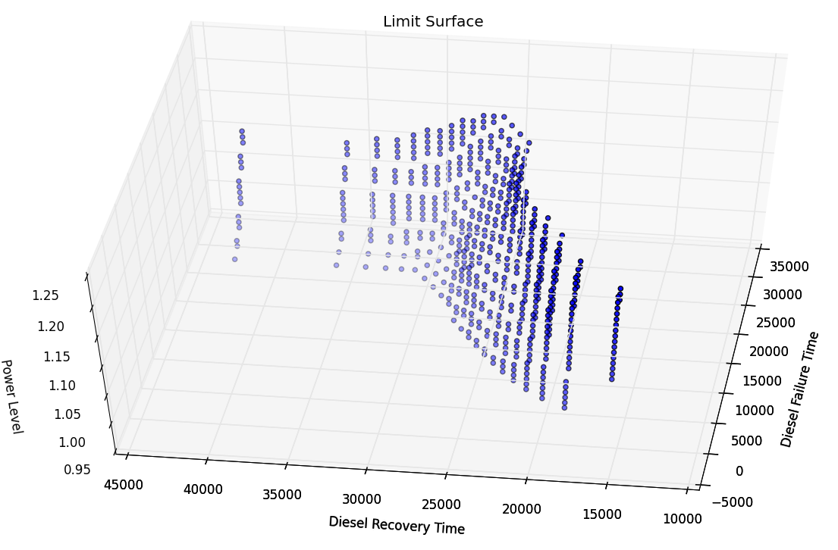
Limit Surface Example
Safe Region
Failure Region

Slide 31
Adaptive Dynamic Event Tree (A-DET)
The next point is mapped into the database of already-executed branches
Only the last part of the simulation is run
The DE’s intrinsic characteristic of following failure patterns provides a more effective training set than other random sampling approaches

Slide 32
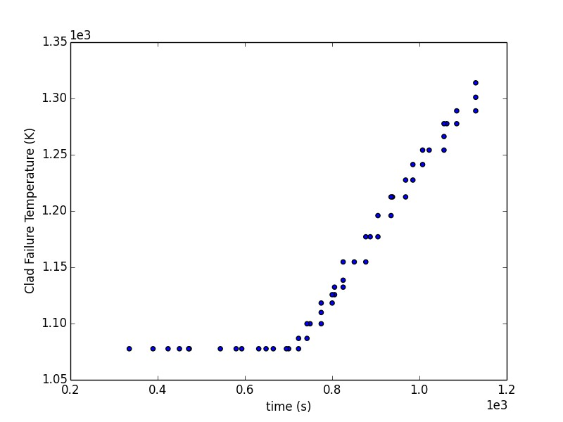
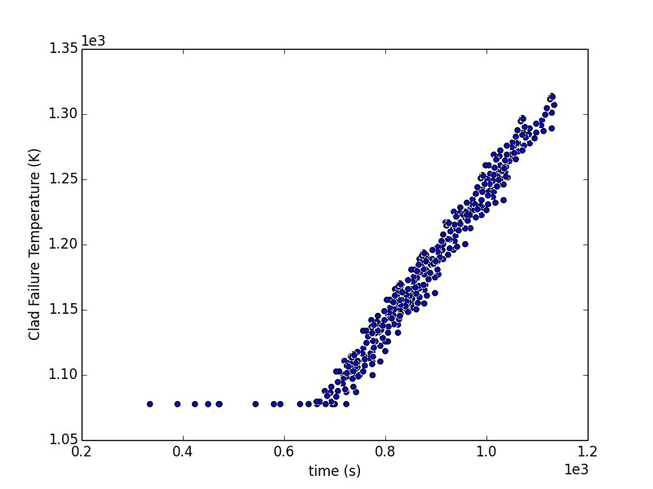
Dynamic Event Tree Demo
Training
Convergence
No density increase

Slide 33
Databases and IO
RAVEN posses the capability to dump the internal data in:
HDF5 databases
CSV files (raw output plus metadata)
Both HDF5 and CSV could be used to recreate the data set during sub sequential simulations

Slide 34
Stochastic Polynomials
It is a special type of surrogate model
It requires a specific sampling strategy
Some of the information of statistical relevance are analytical from the coefficients of the surrogate model
Polynomial Representation
Given a quantity of interest:
Represent as combination of polynomials:
Simpler to evaluate
Easy to get statistical moments
Less effort and more accurate than Monte Carlo

Slide 35
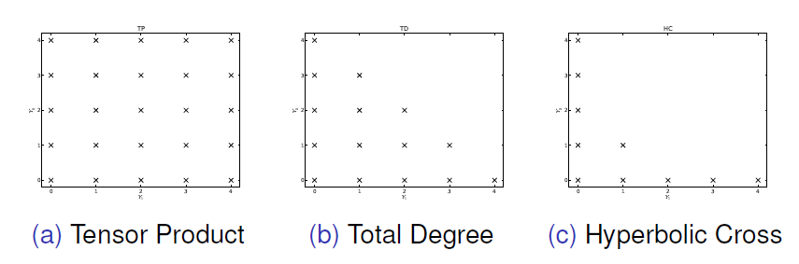
Stochastic Collocation
Effectiveness depends on:
Regularity of quantity of interest
Polynomial expansion order
Polynomial combination indices
Sparse Grid quadrature types (Gauss, Clenshaw)
Number of uncertain inputs
Tensor Product: Overkill
Total Degree: For Analytic Uncertainty
Hyperbolic Cross: For Irregular Uncertainty

Slide 36
Reduced Polynomial Sets
Tensor Product
Overkill
Total Degree
For Analytic Uncertainty
Hyperbolic Cross
For Irregular Uncertainty

Slide 37
Application of Stochastic Polynomials
Statistic | Mean (x10^8) | Std. Dev. | Failure Pb | Solves | Err Stdev *Runs
BISON MC | 5.84360195 | 4.75237678 | 0.0986 | 10000
J_HC2 | 5.13E-06 | 8.91E-03 | 7.61E-02 | 7 | 0.0624
J_HC4 | -3.48E-05 | 9.95E-03 | 7.10E-02 | 31 | 0.3084
J_HC8 | -2.35E-05 | 9.63E-03 | 7.91E-02 | 153 | 1.4736
J_TD2 | -2.60E-05 | 6.41E-01 | 8.01E-02 | 25 | 16.0187
J_TD4 | -2.93E-05 | 9.64E-03 | 7.61E-02 | 165 | 1.5899
J_TD8 | -1.92E-05 | 9.19E-03 | 7.71E-02 | 2097 | 19.2691
L_HC2 | 1.70E-04 | -6.88E-02 | -1.38E-01 | 7 | 0.4818
L_HC4 | 3.38E-05 | -1.91E-02 | 1.38E-01 | 31 | 0.593
L_HC8 | 1.71E-05 | 3.32E-03 | 8.72E-02 | 153 | 0.5087
L_TD2 | 1.52E-04 | -6.90E-02 | 8.82E-02 | 25 | 1.7261
L_TD4 | 1.53E-05 | -1.87E-02 | 1.20E-01 | 165 | 3.0929
L_TD8 | -1.28E-05 | 1.35E-03 | 7.10E-02 | 2097 | 2.8219

Slide 38
Structured Sensitivity Analysis via Topological Decomposition
(a) Decompose the domain based on gradient flow from/to local minima/maxima
(b) Fit a linear regressor to each local segment of the data

Slide 39
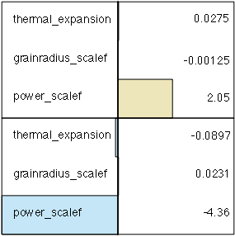
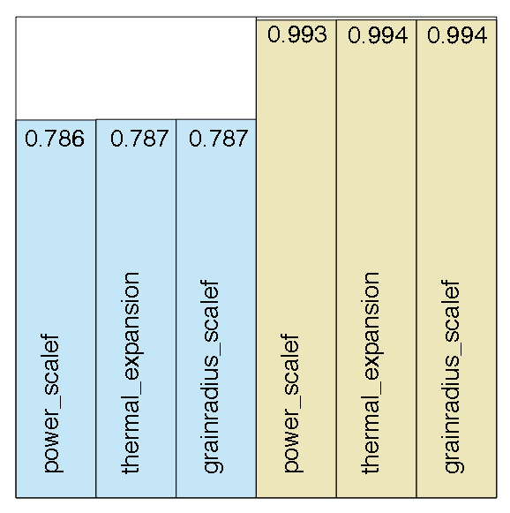
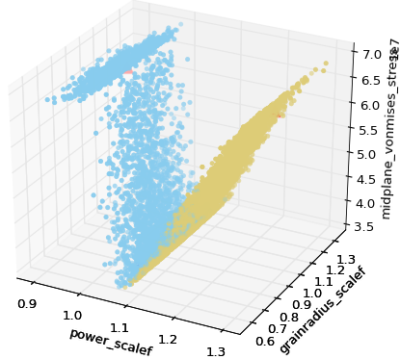
Application to BISON Fuel Analysis
~17,000 simulations
3 input parameters:
power_scalef = Power scaling factor of the core
grainradius_rscalef = Scaling factor of the grain size in the fuel microstructure
thermal_expansion = Thermal expansion coefficient of the fuel
Response value: Midplane Von Mises Stress
Goal: Determine most sensitive parameters within each subset of the domain

Slide 40
How to get the Code
RAVEN is available for free to:
University (no commercial use allowed)
DOE
RAVEN license is worded such that INL retains the intellectual property of any new developments from third parties
We are currently talking with commercial entities and we would be interested in supporting commercial applications
Contact: cristian.rabiti@inl.gov, beth.jagger@inl.gov

